Slide 1
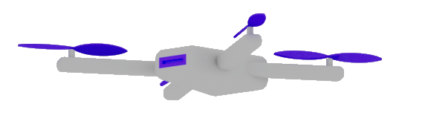
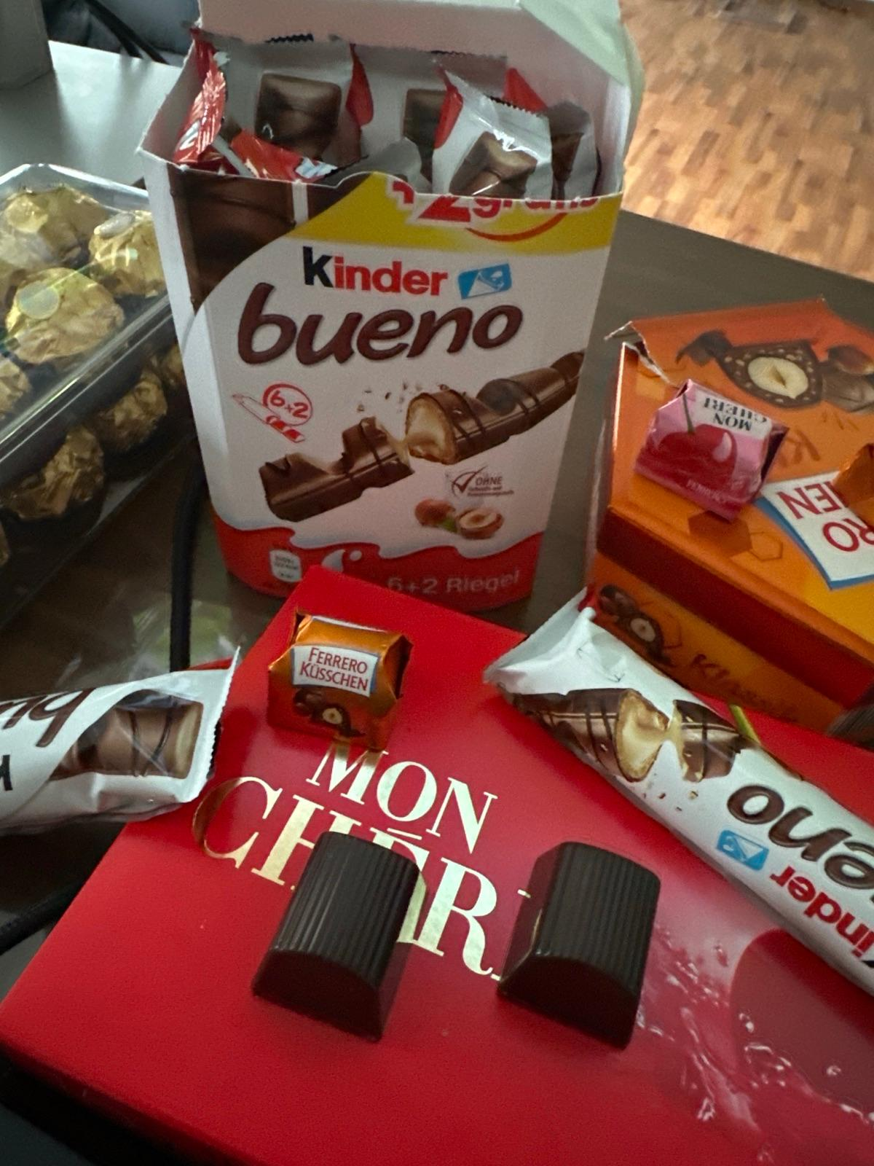
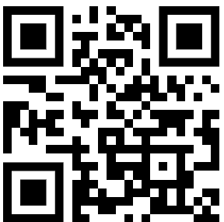
LLM
Dr. Damir Dobric
Lead Software Architect daenet GmbH / ACP Digital
Microsoft Regional Director,
Most Valuable Professional: Azure + IoT

Slide 2
Microsoft confidential
https://github.com/ddobric/semantic-kernel-training/

Slide 3
GENERATIVE AI

Slide 4
What is a Model?
A model refers to a specific instance or version of an LLM AI

Slide 5
Available GPT Models
Ada
basic natural language understanding
classification, sentiment analysis, summarization, and simple conversation.
Babbage
more complex natural language tasks, such as reasoning, logic, arithmetic, and word analogy.
Curie
advanced natural language tasks, such as text-to-speech, speech-to-text, translation, paraphrasing, and question answering.
Davinci
Handles almost any natural language task,
as well as some multimodal tasks, such as image captioning, style transfer, and visual reasoning.
It can also generate coherent and creative texts on any topic, with a high level of fluency, consistency, and diversity.

Slide 6
AI Services
Open AI
https://platform.openai.com/docs/models
Azure Open AI https://oai.azure.com/portal/****/models
Request Access to Azure OpenAI Service (microsoft.com)

Slide 7
DEMO
Open AI Playground
Azure Open AI Playground

Slide 8
Generative Model Types
Embeddings Models
Completion Models
Chat Models
Semantic Search Applications
The application is based on Completion (prompts)
Chat-GPT Application

Slide 9
Completion Models
Summarize following scientific abstract, using a user-friendly language.
[Abstract] Sparse representation has attracted much attention from researchers in fields of signal processing, image processing, computer vision, and pattern recognition. Sparse representation also has a
good reputation in both theoretical research . . .
Completion Playground - OpenAI API

Slide 10
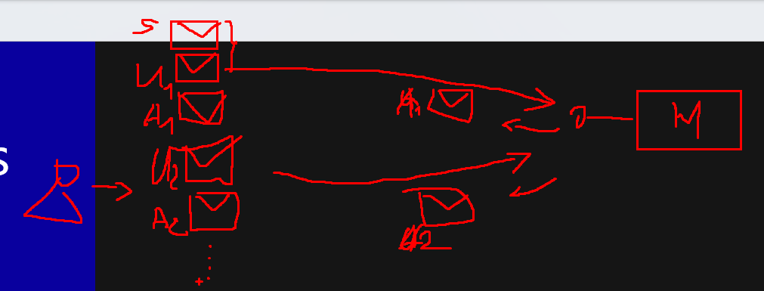
Chat Models
Bot: How can I help you?
User: What's the weather like today?
Bot: Where are you located?
User: I'm in Frankfurt.
Bot: It’s 22 degrees and sunny in Frankfurt today.
User: Thanks! Can you explain scientific abstracts?
Bot: Yes. Please provide abstract.

Slide 11
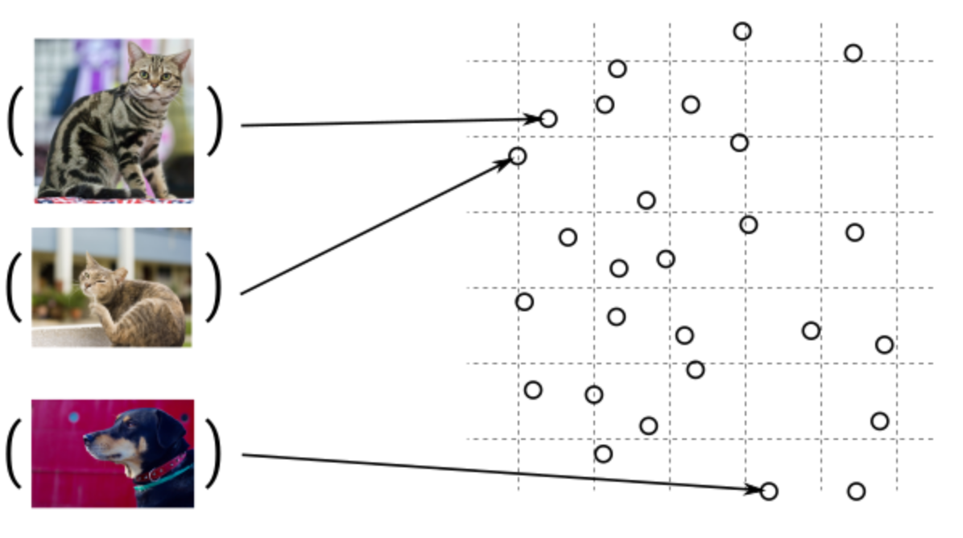
Guess, today is a nice day in Palma
Embedding Models
Today is a typical German rainy day
Two things are infinite: the universe and human stupidity; and I'm not sure about the universe.

Slide 12
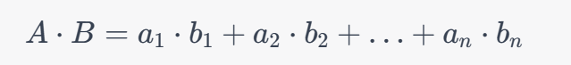
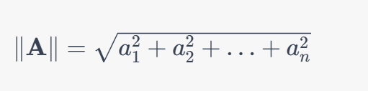
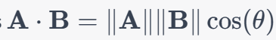
Similarity Between Multidimensional Vectors
Dot Product
The Norm
Cosine Similarity

Slide 13
DEMOs
Consuming AI Service as a REST Endpoint
Using Completions
Generating Embeddings

Slide 14
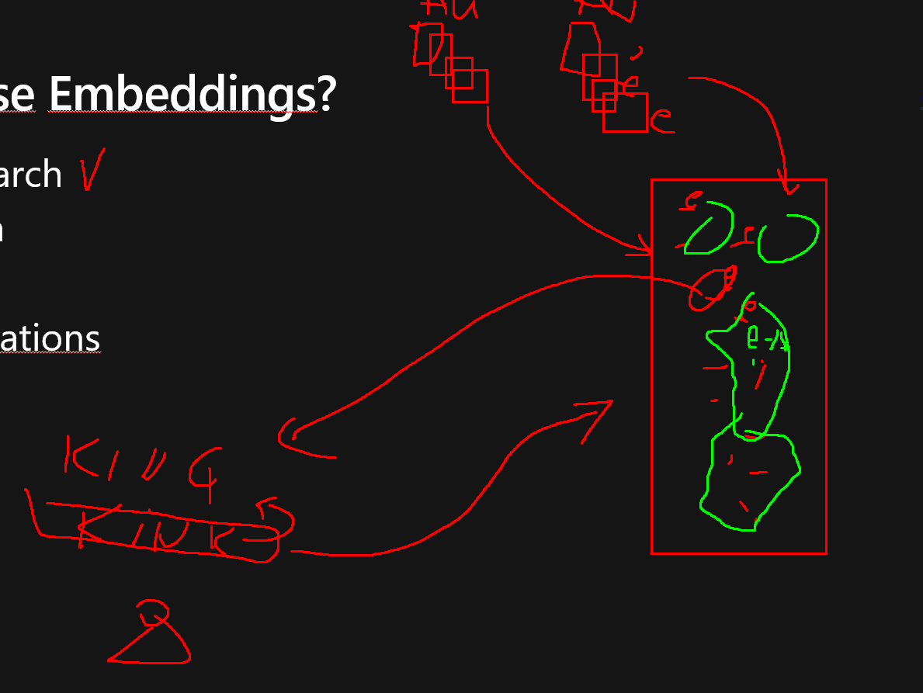
When to use Embeddings?
Semantic Search
Classification
Clustering
Recommendations
. . .

Slide 15
Tokens
1 token ~= 4 chars in English
1 token ~= ¾ words
100 tokens ~= 75 words
Byte Pare Encoding (Gage,1994): Wikipedia
Tokenizer: https://platform.openai.com/tokenizer
What are tokens and how to count them?
Token Pricing: Pricing (openai.com)

Slide 16
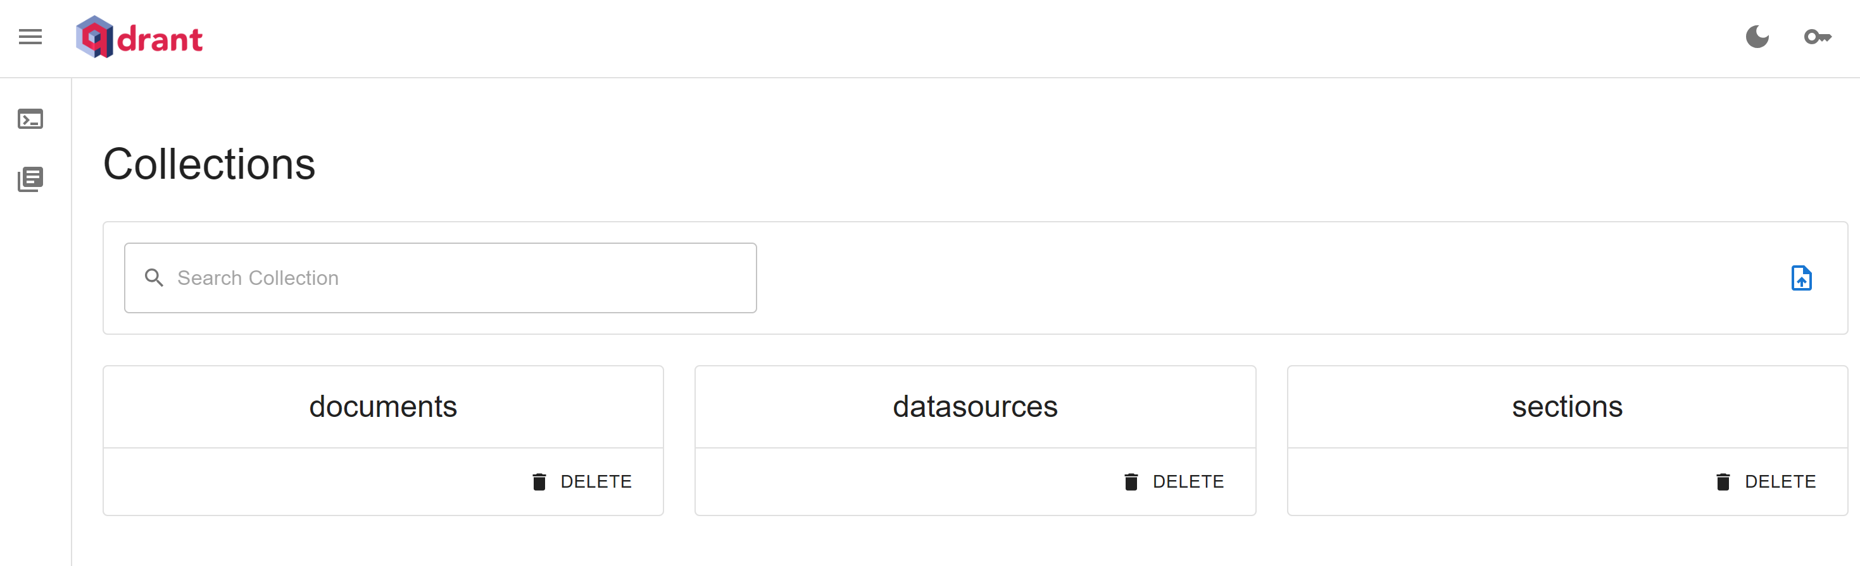
qDrant DB
Vector Search

Slide 17
SQL Server 2025
Native Vector Search
SQL Server Native Vector Search for .NET Developers - Azure SQL Devs’ Corner
azure-sql-db-vector-search/DotNet at main · Azure-Samples/azure-sql-db-vector-search

Slide 18
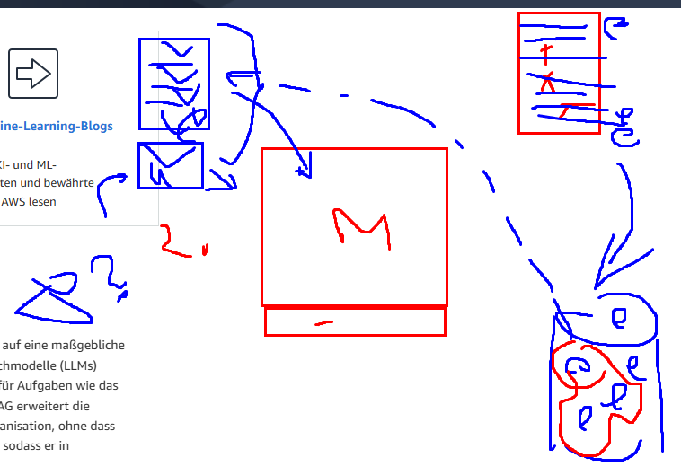
RAG

Slide 19
OPEN AI API

Slide 20
DEMOs
Using OpenAPClient
https://github.com/openai/openai-dotnet

Slide 21
SEMANTIC KERNEL

Slide 22

Software V2
Eine neue Generation von Software
“After tomorrow”
“Tomorrow”
Quantum Computing
Software
Today
AI & Large Language Model Integration
Syntax Driven Languages

Slide 23
Semantic Kernel is an open-source SDK that lets you easily combine Generative AI Models syntactic programming languages like C#, Python an JAVA.
Currently supported languages: C#, Python
Currently supported AI Services: OpenAI, Azure OpenAI, and Hugging Face
Introduction | 🦜️🔗 Langchain

Slide 24
What is an Agent?
An agent is an AI that can:
Answer questions
Automate processes for users
. . .

Slide 25
What is a Copilot?
A Copilot is an AI application that consists of one or more agents,
which orchestrate tasks.

Slide 26
Why to use SK?
SK is a framework to build agents
You can easily use LLM models for chat, create images and video so on.
Making automated Agents that automate business processes is hard?
You need a framework for such complex engineering tasks.

Slide 27
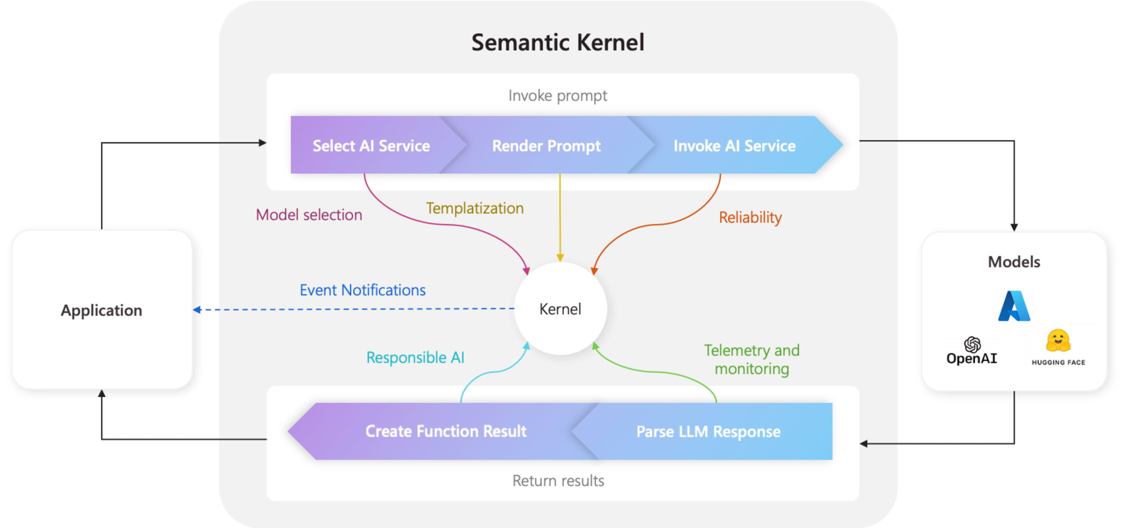
Architecture of the “Smart” application

Slide 28
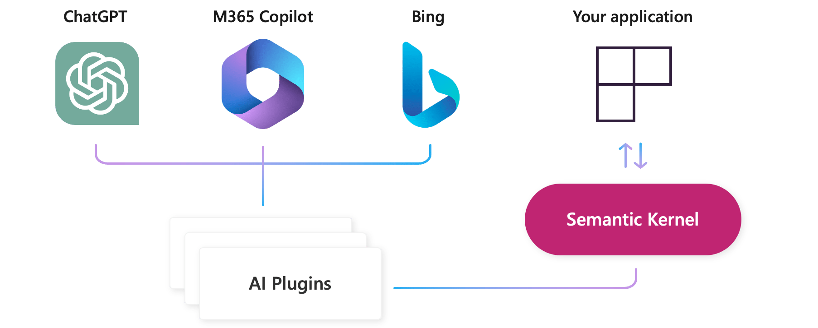
AI Plugins
Your SK application
a plugin is a group of functions
that can be exposed to AI applications
OpenAI plugin specification

Slide 29
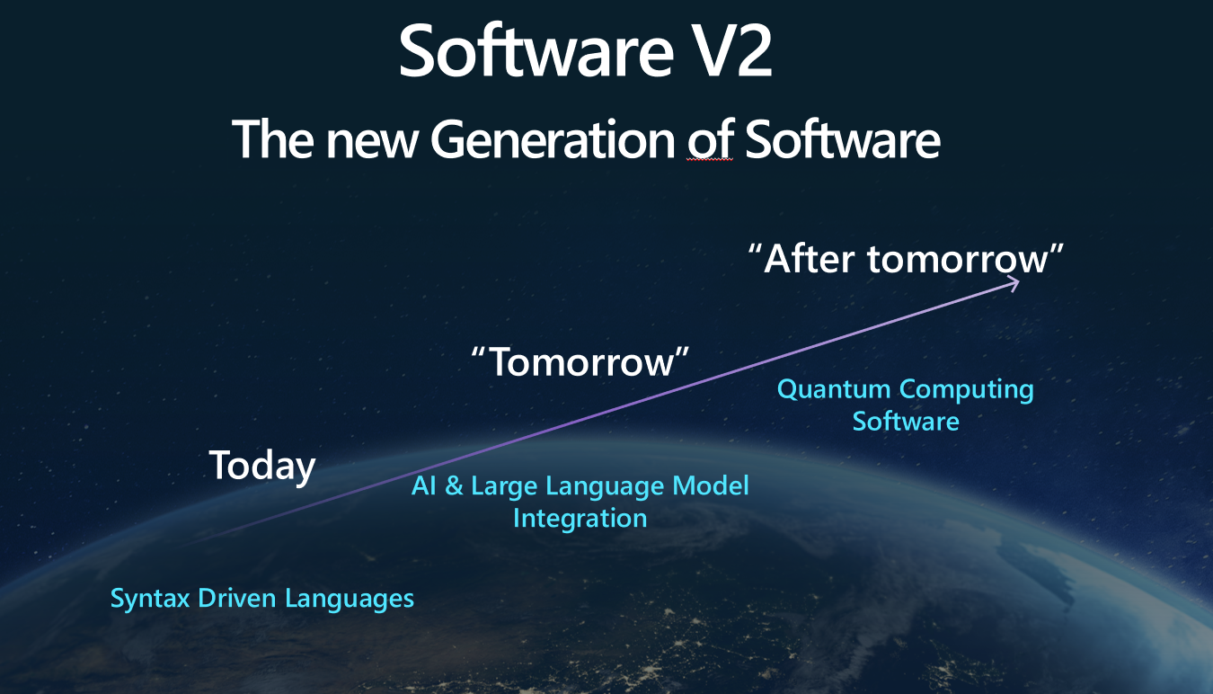
The Knowledge is inside Plugins
Native Functions (C#, Python, JAVA, ??)
Prompts (Semantic Functions)

Slide 30
Deep Dive into Semantic Kernel
Overview of the kernel
Creating native functions
Creating semantic functions
Understanding AI plugins
Chaining functions together
Planer
Create and run a ChatGPT plugin

Slide 31
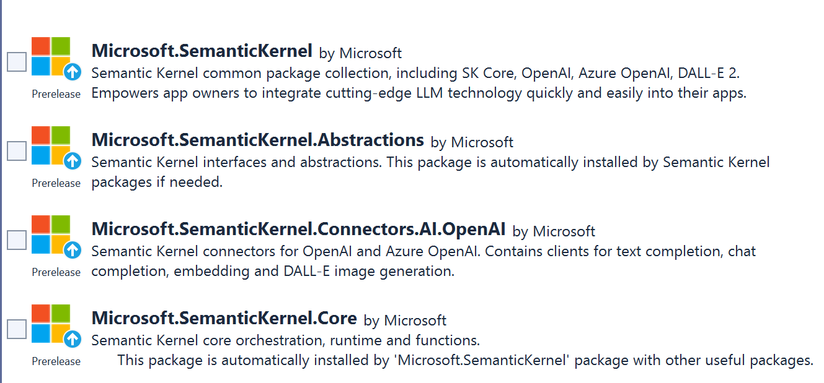
SEMANTIC KERNEL OVERVIEW

Slide 32
Semantic Kernel Initialization with OpenAI
private static IKernel GetAzureKernel()
{
var kernel = kernel = Kernel.CreateBuilder()
.AddOpenAIChatCompletion(
Environment.GetEnvironmentVariable("OPENAI_CHATCOMPLETION_DEPLOYMENT")!,
Environment.GetEnvironmentVariable("OPENAI_API_KEY")!,
Environment.GetEnvironmentVariable("OPENAI_ORGID")!)
.Build();}

Slide 33
Semantic Kernel Initialization with Azure OpenAI
private static IKernel GetKernel()
{
var kernel = kernel = Kernel.CreateBuilder()
.AddAzureOpenAIChatCompletion(
Environment.GetEnvironmentVariable("AZURE_OPENAI_CHATCOMPLETION_DEPLOYMENT")!,
Environment.GetEnvironmentVariable("AZURE_OPENAI_ENDPOINT")!, Environment.GetEnvironmentVariable("AZURE_OPENAI_API_KEY")! )
.Build(); }

Slide 34
Two types of functions
Native Functions
Semantic Functions

Slide 35
NATIVE FUNCTIONS
[KernelFunction, Description("Gets the UTC current time.")]
public string UtcNow()
{
return DateTime.UtcNow.ToString();
}
A native function is a function
defined by the code

Slide 36
SEMANTIC FUNCTIONS
Inline Functions
string prompt = @"Bot: How can I help you?
User: {{$input}}
---------------------------------------------
The intent of the user in 5 words or less: ";
A semantic function is a function
defined by the LLM prompt
Plugins
│
│─── Plugin1
│
│─── Function11
│─── Function12
└─── Plugin2
│
│─── Function21
│─── Function22
Add Ins
In-file Functions

Slide 37
Preserving context in Conversation History
Bot: How can I help you?
User: What's the weather like today?
Bot: Where are you located?
User: I'm in Frankfurt.
Bot: It’s 22 degrees and sunny in Frankfurt today.
User: Thanks! Can you explain scientific abstracts?
Bot: Yes. Please provide abstract.

Slide 38
Variables and Context Flow
Context
{{$input}}
{{$var1}}
{{$var2}}
. . .
{{$varN}}
Func1
Func2
prompt

Slide 39
Variables and Context Flow
Context
{{$input}}
{{$var1}}
{{$var2}}
. . .
{{$varN}}
prompt
Func1
Func2

Slide 40
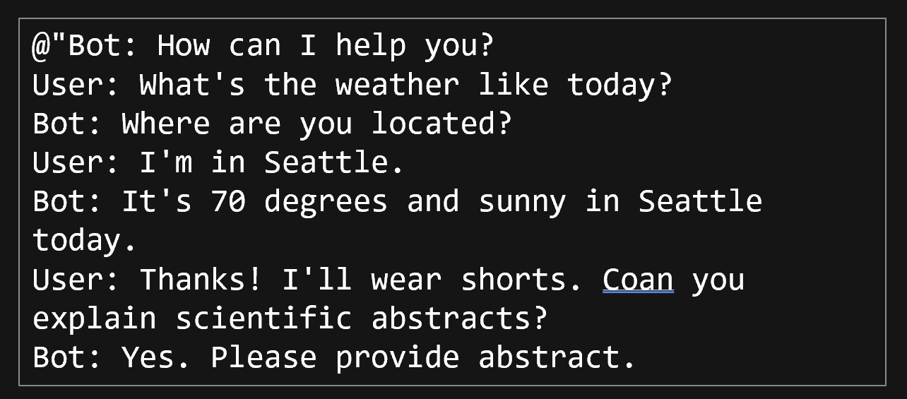
Using Conversation History as variable
[History]
{{$history}}
---------------------------------------------
Summarize scientific abstract, using a user-friendly language.
[Input]
{{$input}}

Slide 41
Using variables (Templatizing), Prompt Template Syntax)
[History]
{{$history}}
User: I'm {{$age}} years old kid.
Bot:Ok, explaining to {{$age}} old kid.
---------------------------------------------
Summarize abstract, using a user friendly language. Use language of the {{$age}} years old kid. Don't use subjects like "we" "our" "us" "your".
If {{$age}} is not on of following options {{$options}} then return an error message similar to 'Sorry, please use some meaningfull age'.
[Input]
{{$input}}
https://learn.microsoft.com/en-us/semantic-kernel/prompt-engineering/prompt-template-syntax

Slide 42
Nested Semantic Functions Semantic function invokes a semantic function
{{SamplePlugin.Translator $input}}
-----------------------------------------------
Summarize and compress abstract to 50 words, using a user friendly language.
[Input]
{{$input}}

Slide 43
Nested Native Functions Semantic function invokes a native function
{{SamplePlugin.Translator $input}}
--------------------------------------
Summarize the scientific abstract using a user friendly language. Counter = {{StringPlugin.CharCount $input}}
Provide the result in following format:
[Output]
Counter: number,
Text: translated text
[Input]
{{$input}}
--------------------------------------
[Output]
Notes:
Lines ----- are important. Without them translation will be done, but not used as a final result. Final result will be summarized abstract without translation.
Interestingly both lines are required.
2. CharCount will be executed with summarized English text instead of translated text. The function is invoked bevore the translator function is invoked.

Slide 44
Chaining Functions
string myJokePrompt = """
Tell a short joke about {{$input}}.
""";
string myPoemPrompt = """
Take this "{{$input}}" and convert it to a nursery rhyme.
""";
string myMenuPrompt = """
Make this poem "{{$input}}" influence the three items in a coffee shop menu.
The menu reads in enumerated form:
""";
var myJokeFunction = kernel.CreateSemanticFunction(myJokePrompt, requestSettings: sett);
var myPoemFunction = kernel.CreateSemanticFunction(myPoemPrompt, requestSettings: sett);
var myMenuFunction = kernel.CreateSemanticFunction(myMenuPrompt, requestSettings: sett);
// Get the GetIntent function from the OrchestratorPlugin and run it
var result = await kernel.RunAsync(new ContextVariables("Damir Dobric Microsoft Regional Director"),
myJokeFunction, myPoemFunction, myMenuFunction);

Slide 45
AI Plugins
Your SK application
a plugin is a group of functions
that can be exposed to AI applications
OpenAI plugin specification

Slide 46
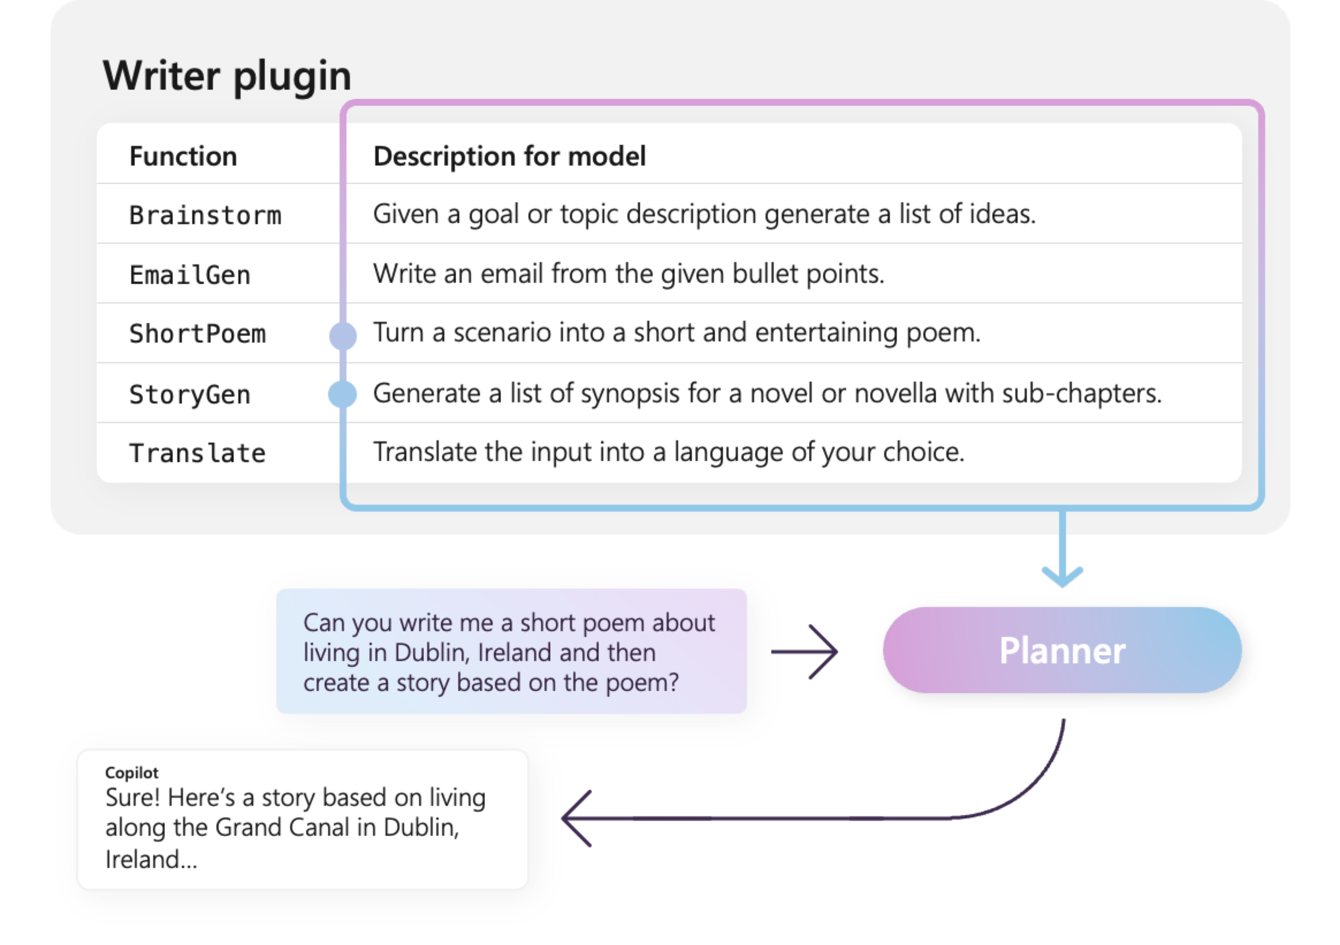

Slide 47
Planers
Planner is a function
I takes a prompt and returns back a plan on how to accomplish the task described in the prompt.
Mix-and-match the plugins.
Recombine them into a series of steps that complete a goal.
Converts the prompt into
orchestration of functions
implemented in Plugins
If my investment of 2130.23 dollars increased by 23%, how much would I have after I spent $5 on a latte?
Planers

Slide 49
The plan is a mapping
The plan is mapping from prompt to the set of functions
m: prompt -> {f1,f2,..,fN}

Slide 50
All starts with the Goal
"Summarize an input, translate to klingon, and e-mail to Damir”

Slide 51
Plan execution
kernel.ImportSemanticSkillFromDirectory(folder,
"SummarizeSkill",
"WriterSkill");
var plan = await planner.CreatePlanAsync("Summarize an input, translate to klingon, and e-mail to Damir");
var input = "Once upon a time, in a faraway kingdom, there lived a kind and just king named Arjun. " +
"He ruled over his kingdom with happily ever after, with the people of the kingdom remembering Mira as the brave young woman who saved them from the dragon.";
await ExecutePlanAsync(kernel, plan, input, 5);

Slide 52
SK creates the plan for a given goal
<goal>Summarize the input, then translate to Klingon and email it to Damir</goal>
<plan>
<function.WriterSkill.Summarize/>
<function.LanguageHelpers.TranslateTo translate_to_language="Japanese" setContextVariable="TRANSLATED_TEXT" />
<function.EmailConnector.LookupContactEmail input="Martin" setContextVariable="CONTACT_RESULT" />
<function.EmailConnector.EmailTo input="$TRANSLATED_TEXT" recipient="$CONTACT_RESULT"/>
</plan>

Slide 53
The plan is created from Semantic Function
Create an XML plan step by step, to satisfy the goal given.
To create a plan, follow these steps:
0. The plan should be as short as possible.
1. From a <goal> create a <plan> as a series of <functions>.
2. Before using any function in a plan, check that it is present in the most recent [AVAILABLE FUNCTIONS] list. If it is not, do not use it. Do not assume that any function that was previously defined or used in another plan or in [EXAMPLES] is automatically available or compatible with the current plan.
3. Only use functions that are required for the given goal.
4. A function has a single 'input' and a single 'output' which are both strings and not objects.
5. The 'output' from each function is automatically passed as 'input' to the subsequent <function>.
6. 'input' does not need to be specified if it consumes the 'output' of the previous function.
7. To save an 'output' from a <function>, to pass into a future <function>, use <function.{FunctionName} ... setContextVariable: "<UNIQUE_VARIABLE_KEY>"/>
8. To save an 'output' from a <function>, to return as part of a plan result, use <function.{FunctionName} ... appendToResult: "RESULT__<UNIQUE_RESULT_KEY>"/>
9. Append an "END" XML comment at the end of the plan.

Slide 54
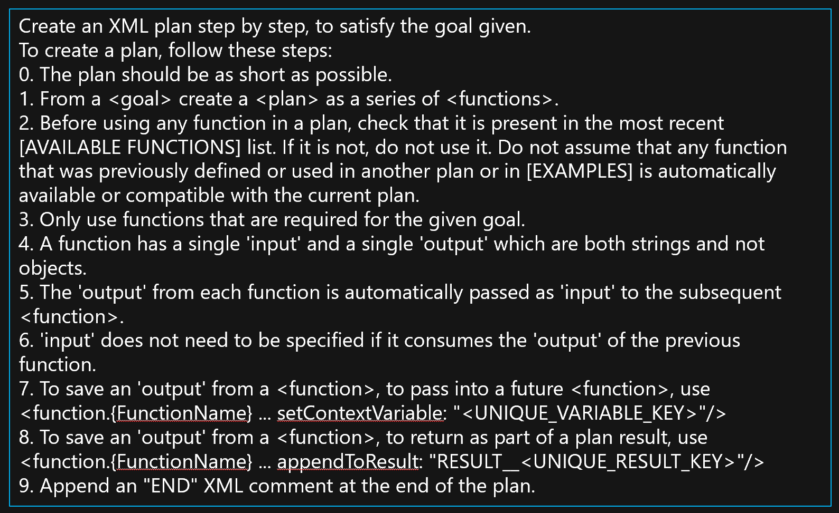
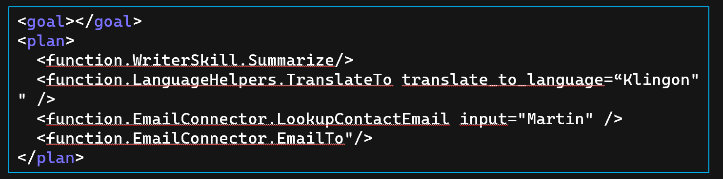
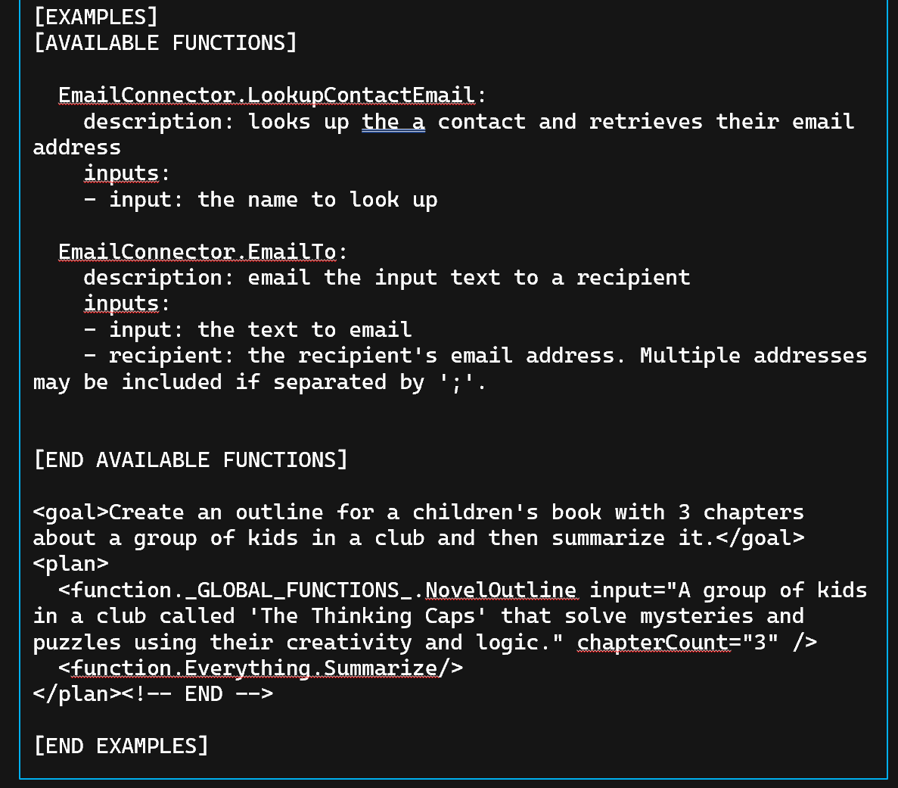
Mapping the Goal to Functions
Davinci completion model
GPT4 Model

Slide 55
How does the planer work?
<goal>Summarize the input, then translate to Klingon and email it to Damir</goal>
<plan>
<function.WriterSkill.Summarize/>
<function.LanguageHelpers.TranslateTo translate_to_language=“Klingon" setContextVariable="TRANSLATED_TEXT" />
<function.EmailConnector.LookupContactEmail input="Martin" setContextVariable="CONTACT_RESULT" />
<function.EmailConnector.EmailTo input="$TRANSLATED_TEXT" recipient="$CONTACT_RESULT"/>
</plan>

Slide 56
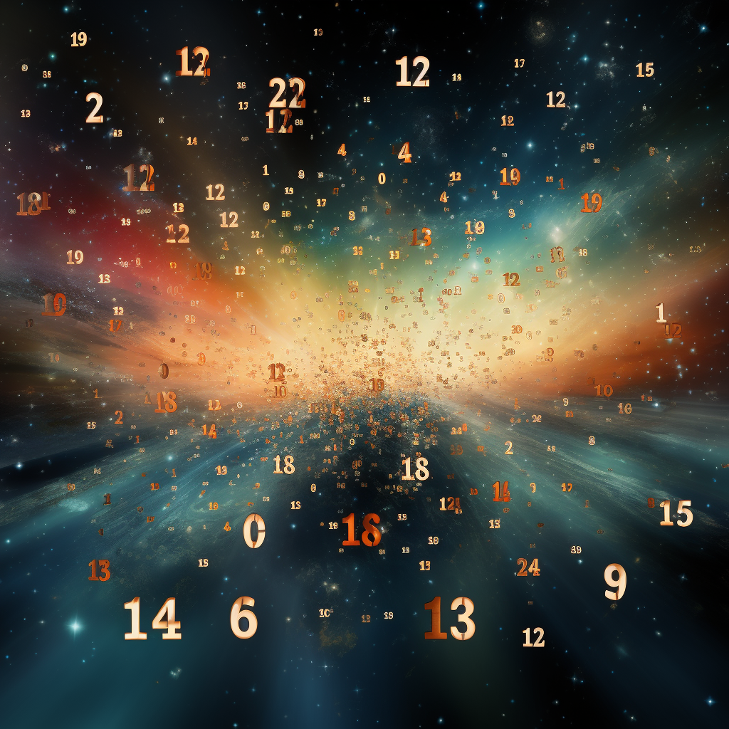
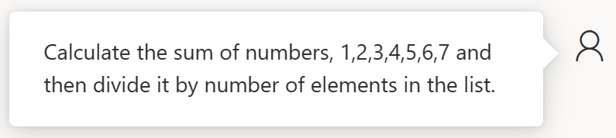

Slide 57
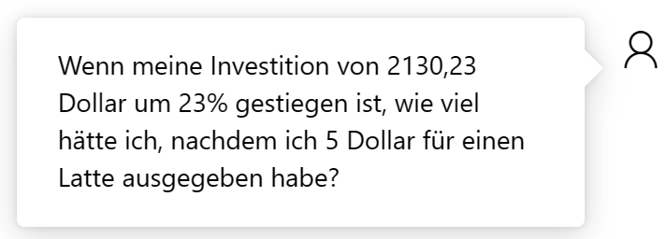
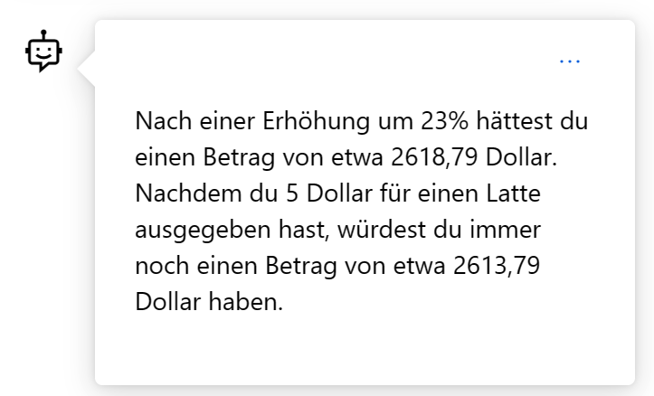

Slide 58

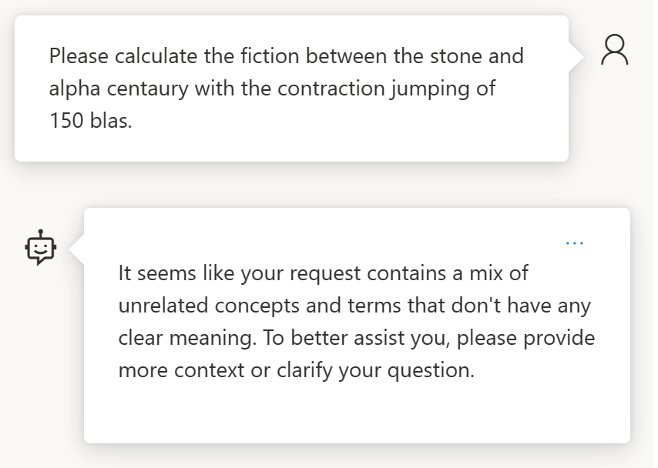
How about something not solvable?

Slide 59


References
Azure/aistudio-copilot-sample at oct-refresh (github.com)
Microsoft Copilot Studio
Azure AI Studio
Semantic Kernel
AI-Generated 3D Worlds
Imagine AI Art Generator
Midjourney
Azure AI SDK - Azure AI Studio
BOOK OF NEWS - Microsoft Ignite

Slide 60
Azure OpenAI und Semantic Kernel für Softwareentwickler
Dr. Damir Dobric
Lead Software Architect daenet GmbH / ACP Digital
Microsoft Regional Director,
Most Valuable Professional: Azure + IoT

Slide 61
Microsoft confidential
Pause: 10.30-11.00
https://github.com/ddobric/semantic-kernel-training/settings/access

Slide 62
